Slide 1


FIT1045: Algorithms and Programming Fundamentals in Python Lecture 1 Introduction to Algorithms
Images at http://bloggertowordpresstestblog.blogspot.com.au/2009/11/michael-hansmeyer-solids-at-smallspace.html:
COMMONWEALTH OF AUSTRALIA
Copyright Regulations 1969
WARNING
This material has been reproduced and communicated to you by or on behalf of Monash University pursuant to Part VB of the Copyright Act 1968 (the Act).The material in this communication may be subject to copyright under the Act.Any further reproduction or communication of this material by you may be the subject of copyright protection under the Act.
Do not remove this notice.

Slide 2
What’s this unit about
Algorithms
A sequence of steps to solve problems
We will cover a wide variety of algorithms to solve different problems
Programming language
a mean to communicate with computers (e.g., how to express an algorithm to a computer)
We will use Python programming language: a powerful programming language and arguably the closest to English
Like any spoken language, practice is the key. More you practice the better you can communicate.
Unit Objectives
To learn how to:
Develop algorithms
Communicate algorithms
Reason about algorithms
Understand the limitations of algorithms
Implement algorithms in Python

Slide 3
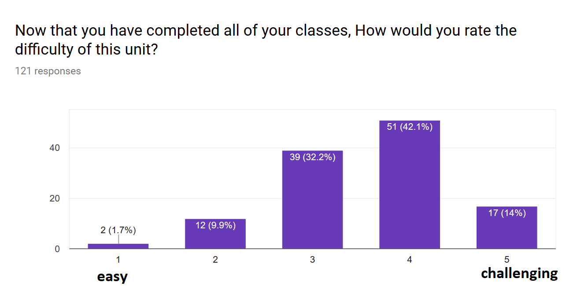
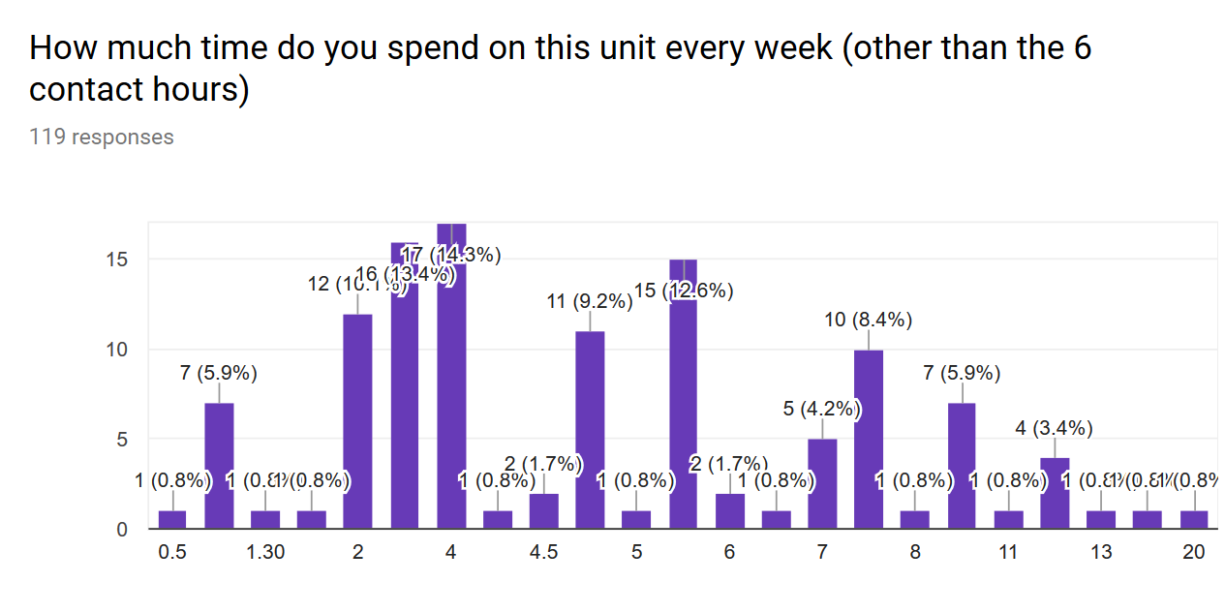
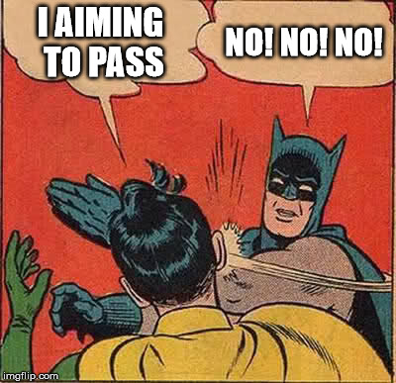
Expectations
insufficient
recommended
hardcore
This unit will be challenging
It will require you to practice some self study and work with other students
If you are merely aiming to pass, you are going to fail (at all things)
This unit can actually be a lot of fun if you take it seriously!

Slide 4

Advice from past students
Practice programming all. The. Time. Lots.
Practise coding in python regularly, using all the tools/strategies/methods being taught. Always be updating your own coding strategies; don't be afraid to change the way you do something if you discover a new, better way.
Go over the lecture slides after each lecture & write some short notes on the concepts. & re-visit workshop tasks so that you don't forget how to do certain things.
Seek help if you are having trouble with the coding part (from consultations, other students, past students etc.)
Be prepared to do a lot of self study.
Take the small things seriously like the 1% of quizzes and workshop as they add up from day 1.
It's challenge, but not impossible. You just need to put your mind to it, and so it can be done, take me for example, no clue when I started the unit, but now can code so much.
Be smart and attend all the lectures (which I didn't), the tutorials and workshops will be so much easier. And go to the consultations if you don't understand!!
the first lectures may seem hard but keep up with the practical work and it will all make sense at the end.. it seems harder than it actually is
Try doing the workshop tasks or at least some of them before you go to the workshop. You'll get a lot more out of the workshop if you have difficulty.
- Keep on top of readings, tutorial work and workshop tasks. - Reattempt workshops and implement new knowledge (especially after learning about functions and recursion). - Never let misconceptions build up, because there are a lot of interconnected concepts in this unit. This can mean if you don't understand one thing, these misunderstandings could potentially amplify with each week. - Bookmark Python Tutor - it is excellent!
Focus on understanding the approaches to problem solving, such how sorting algorithms are broken down. This is much more beneficial than just memorising lines of pseudocode or python.
To use sites like codeacademy even before the semester starts to get used to the syntax and get a head start on the language.
Make friends with someone who has coding experience or form a weekly study group.
Start the assignment early. Have a look at the labs before your scheduled lab time. And do the presentation.

Slide 5
Transferrable skills from this unit
Teamwork (from active participation in workshops and tutorials)
Planning and problem solving (assignments, workshops)
Communication (active participation in workshops and tutorials)
Presentation skills (if you do the optional presentation)
Version control (we’ll push you to use git but we won’t force you)

Slide 6


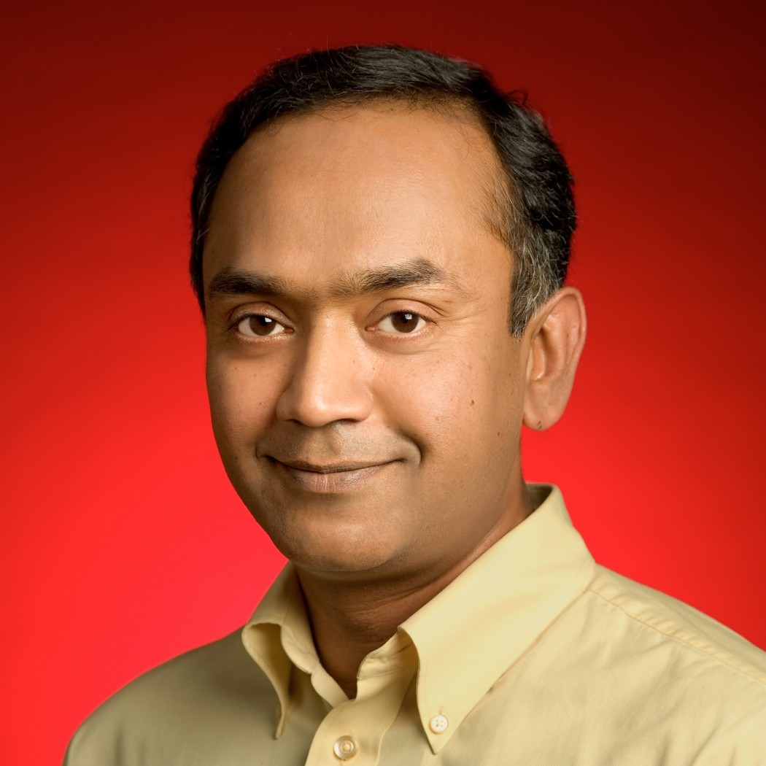
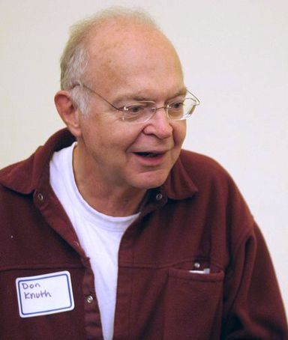

Computer Scientists are amazing!
Annie Easley;
Computer scientist, Mathematician, Rocket scientist with NASA for ~32 years
Helped develop the Centaur rocket system (got Cassini to Saturn!)
(left)
Admiral Grace Hopper;
Computer scientist, American Navy Admiral; involved in development of FORTRAN, COBOL
(right)
Ramanathan V. Guha;
Computer scientist, creator of RSS, worked on Google’s custom search and adwords
(left)
Donald Knuth;
Computer scientist, mathematician, author. Developed the TeX typesetting system, and wrote the widely read “The Art of Computer Programming” (Turing award worthy)
(right)
Satoshi Nakamoto;
Computer scientist/cryptographer. Developer of the bitcoin; ???
(left)

Slide 7
This lecture
What are algorithms
Running lectures
Unit structure
Assessment
Getting help
Learning outcomes: (recognise the relcationship between a problem description and program design)

Slide 8
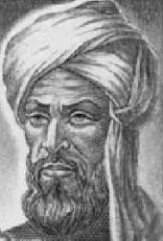
What is an Algorithm?
Image at: vindelz.wordpress.com/2009/11/algorismi1.jpg
al-Khwarizmi
(c. 780 – 850)

Slide 9
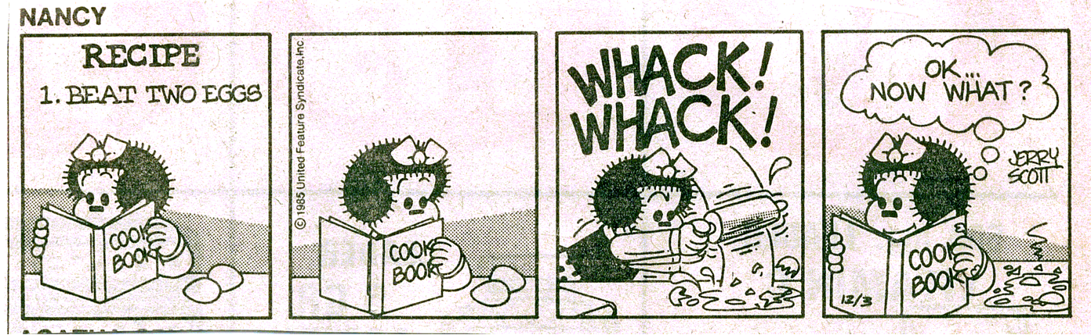
Like a recipe
This image is copyright protected. The copyright owner reserves all rights.

Slide 10
A recipe (Mousseline au chocolat)
Melt chocolate and 2 tablespoons water in double boiler. When melted, stir in powdered sugar; add butter bit by bit. Set aside. Beat egg yolks until thick and lemon-colored, about 5 minutes. Gently fold in chocolate. Reheat slightly to melt chocolate, if necessary. Stir in rum and vanilla. Beat egg whites until foamy. Beat in 2 tablespoons sugar; beat until stiff peaks form. Gently fold whites into chocolate-yolk mixture. Pour into individual serving dishes. Chill at least 4 hours. Serve with whipped cream, if desired. Makes 6 to 8 servings.
Sinclair and Malinowski, French Cooking, Weathvane Books, 1978

Slide 11
An Algorithm
Fold paper in half.
Unfold and then fold the corners into the center line.
Fold the top edges to the center.
Fold the paper in half.
Fold the sides down to meet the bottom edge of the paper.

Slide 12
Definition
A finite sequence of steps written for an agent (e.g., computer, chef) to solve a problem with the following properties:
Definiteness
Each step must be precisely and unambiguously specified for the agent.
Input
Zero or more.
Output
One or more.
Effectiveness
Each step is sufficiently basic that they can be done exactly and in a finite length of time by the agent.
Finiteness
Must always terminate after a finite number of steps.
Called process if satisfies all of the above properties except finiteness
Definiteness vs Effectiveness
The agent following the instruction must
understand WHAT to do (definiteness)
be ABLE to do it (effectiveness)

Slide 13
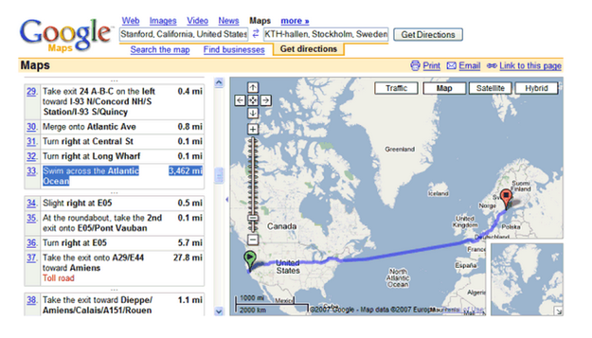

Slide 14
How to reach my office
Go to IT building
Take elevator to first floor
Turn right
…
“Go to IT building” does not satisfy definiteness, e.g., which IT building
“Go to 25 Exhibition Walk, Clayton” satisfies definiteness but not effectiveness because the agent may not know how to reach there

Slide 15
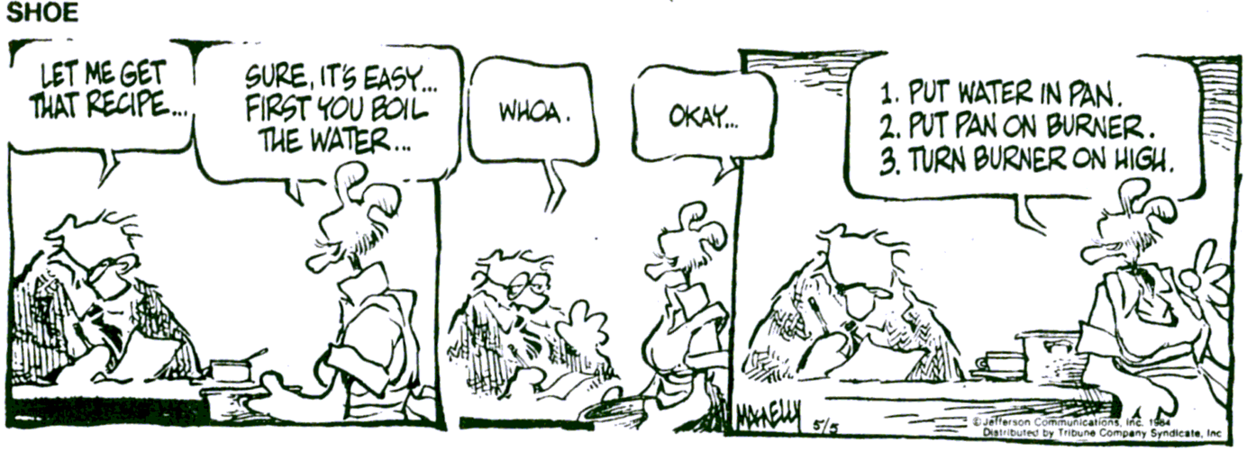
Level of Detail

Slide 16
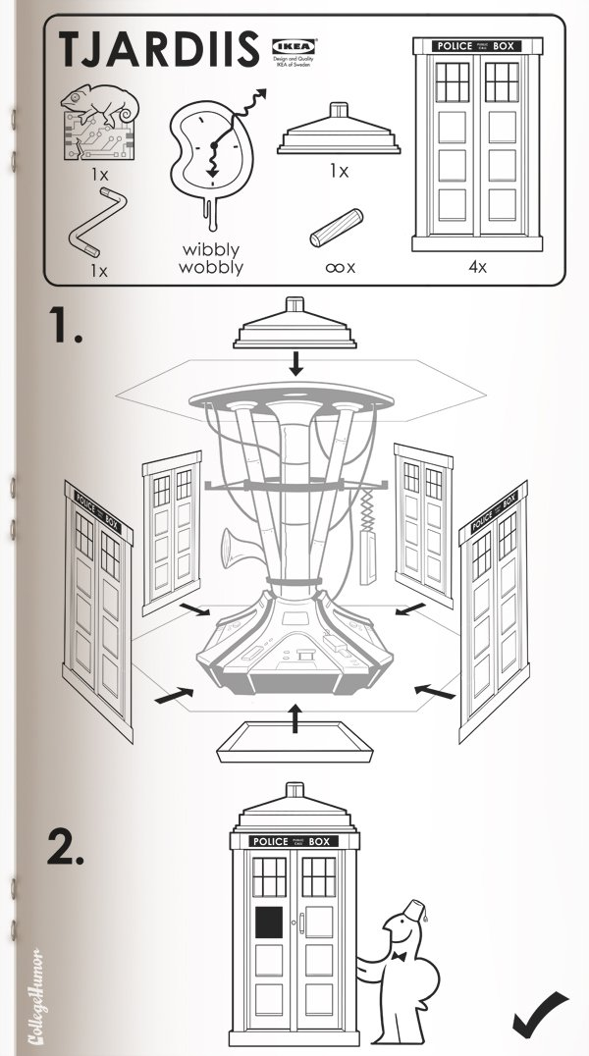
Consider
Recipes
Navigation
Installation guides
Programs
http://www.collegehumor.com/article/6500868/sci-fi-ikea-manuals

Slide 17
Where am i?
What are algorithms
Running lectures
Unit structure
Assessment
Getting help

Slide 18
Lecturer
Reza Haffari
Room 131A, 25 Exhibition Walk, Clayton
Email: gholamreza.haffari@monash.edu
Consultation: TBA

Slide 19
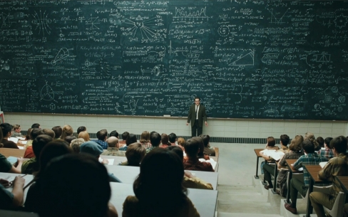
Conventional Lectures
http://www.pedagogygeek.com/category/uncategorized/

Slide 20

Some Issues
http://gregteselle.com
Difficult for students to remain attentive.
Not enough opportunity to critically think through the concepts.
Reinforces the feeling that the most important part of learning is to memorize material.
Difficult for lecturers to gauge students’ understanding.

Slide 21

Peer Instruction

Slide 22

The Approach
Lectures are interspersed with questions.
You are given some time to think about the question
You then give your responses.
We look the responses.
You then spend some time discussing your answers with the students around you.
You respond again.
We then look at the responses and discuss them as a class.

Slide 23
Using MARS
Visit http://mars.mu on your internet enabled device
Log in using your Authcate details (not required if you’re already logged in to Monash)
Touch the + symbol
Enter the code for your unit: V454V7
Answer questions when they pop up.

Slide 24
Multiple choice questions
1+1 = ?
2
10
11
Cannot tell
Visit http://mars.mu on your internet enabled device
Log in using your Authcate details (not required if you’re already logged in to Monash)
Touch the + symbol
Enter the code for your unit: V454V7
Answer questions when they pop up.
Hint: There are 10 types of people in this world. Those who understand binary and those who don’t.

Slide 25
Text-based poll
Where do you live? (write the name of your suburb)

Slide 26
Where am i?
What are algorithms
Running lectures
Unit structure
Assessment
Getting help

Slide 27
Contact Hours
Lectures (2hrs per week)
Mon 5-6pm (S4 in Bldg 25)
Tues 9-10am (G81 in LTB)
Online (access via Moodle)
Tutorials (2hrs per week)
Workshops (2hrs per week)

Slide 28
Syllabus
Week | Monday Lecture | Tuesday Lecture | Assessment
1 | Introduction to Algorithms | Introduction to Python | Assignment 1,2 released
2 | Selection | Loops and repetition
3 | Introduction to Data Structures | Decomposition and modules
4 | Understanding python | Finding algorithms
5 | Invariants | Greedy algorithms | Project (plan)
6 | Brute force | Mid semester Test | Test (20%) Assignment 1 due
7 | Brute search II | Divide and Conquer | Presentation 1 (optional*)
8 | Recursion | Guest Lecture | Project (feedback response)
9 | Recursive D&C, stacks, queues | Backtracking | Presentation 2 (optional*) Project (final submission)
10 | Implementing Backtracking | Transform and Conquer | Assignment 2 Due
11 | Introduction to Complexity | Complexity for Tree Algorithms | Presentation 3 (optional*)
12 | Intractable/unsolvable Problems | Further applications
Notes:
Give them a brief overview of the course. Describe why puzzles are used throughout the course to explain ideas, i.e., puzzles do not need a lot of background to understand the problem and many of the puzzles are classic problems in computer science. Explain why we do not get them to program in this course, i.e., because we want them to understand the ideas without getting bogged down in the details of the implementation. Also if they understand the ideas they can implement them in whatever language they are using.

Slide 29
Where am i?
What are algorithms
Running lectures
Unit structure
Assessment
Getting help

Slide 30


Assessment
In-semester Marks (max of 60%)
In-class quizzes (10%)
2 Assignments (15% total)
Workshops (5 %)
Team project (10%)
Mid Semester Test (20%)
Optional* presentation: (+5%)
Exam (40%) (2 hours)

Slide 31
Assessment: high level details
Assessment | where | Keep in mind
quizzes | In lectures | Your top mark applies for each week’s lecture
Assignments 1+2 | In your own time | A2 builds on A1, feedback you receive on A1 will help you with A2; interview as hurdle for marks
workshops | In workshop class | Pair programming for half marks, workshop assessed the following week, your top five contribute to final mark
Team project | In your time with your team | Teams will be organised by week 4, multistage, what you create will be helpful for other students
Mid sem test | In lecture | Use the practice mid sems we provided and get feedback on your attempt, first 5 weeks content
Optional presentation* | In consultations | Contact role account to apply, can be repeated to improve marks
…Attend the lecture, though you feel unproductive. 0.5 mark worths 4k dollars…
…also do the presentation to get the bonus marks, it could be the difference between a HD and a D
Have a look at these slides on moodle after class for more information about each

Slide 32
Assessment: In-class quizzes (10%*)
Assessed questions in weeks 1-12
Each lecture is worth .5%
Only 20 lectures will have quizzes
Your mark for a week will come from the question you scored highest on
Eg if there are 3 questions in the first lecture and 4 in the second for the week, you get full marks provided you got at least 1 correct
If you can’t attend, apply for special consideration

Slide 33
Assessment: Assignments 1+2 (15%)
A series of questions requiring you to write Python code to solve different problems
Assignment 2 builds on Assignment 1
Make sure you take on board any feedback from your demonstrator to maximize your marks
Individual
Hurdle: You will have to explain your code to demonstrators in an interview
A1 Due Week 6, A2 Due Week 10
Interview in week 11 (not doing the interview yields 0 marks for assignment)
In S2 2017, students thought it was hard
Most thought they had enough time but only a third felt they made good use of their time

Slide 34
Assessment: Team project (10%)
This will be a multistage project to develop an active learning activity
You will be introduced to some in tutorials
Your team will be given to you in week 4
Stages
Prepare an initial plan (due wk 6)
Submit a draft for feedback (wk 7)
Provide feedback to another team
we will give you a team to provide feedback on
Respond to feedback (due wk 8)
Final submission/presentation (week 12)

Slide 35
Assessment: Workshops (5%)
Practice, practice, practice …
Pair programming
Try to swap who’s programming with each line
Effective pair programming yields 50% marks
Staff are there to assist
Don’t expect to complete all the tasks in 2 hr workshop.
Completing the workshop will normally require you to spend time outside of class
Workshop sheets already on moodle
assessed during the workshop in the following week
Week 12 assessed on the same week
Your top 5 workshops contribute to final marks

Slide 36
Assessment: Presentation (+5%*)
Encourages good communication skills (transferrable skill)
You will give a presentation on an algorithm
check with your tutor to ensure the algorithm you want is appropriate
This involves unstructured investigation, you have to find an algorithm to present on
You can attempt this three times (week 7, 9, and 11); each time you will get feedback that you can improve upon for the next one (if you choose)
These are a bonus* 5% marks, you may want to do this if you lost marks elsewhere (or for the kudos)
Read the specifications carefully, previously many students didn’t respond to a key aspect and lost marks

Slide 37
Assessment: Test and Final Exam
Mid Semester Test (20%)
In week 6, during lecture
40-50 minutes duration
Will cover the content taught in first 5 weeks
Exam (40%) (2 hours)
During Exam period

Slide 38
Moodle Quizzes
Each week there will be a quiz on moodle which will relate to the material covered
These are available from weeks 2 through 11
These should be available for each week from the Friday of that week.
These are NOT the assessed lecture quizzes, you need to attend the lectures to do those.
These are to help you practice

Slide 39
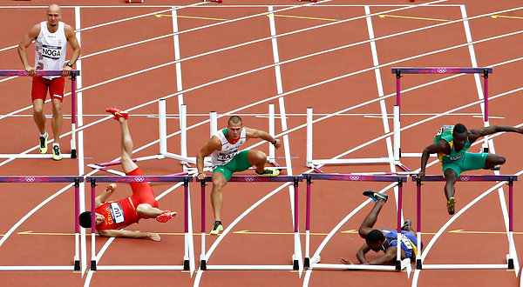
Hurdles
To pass this unit a student must obtain:
40% or more in the unit's examination, and
40% or more in the unit's total non-examination assessment, and
an overall unit mark of 50% or more.
If a student does not pass these hurdles then a mark of no greater than 49N will be recorded for the unit.
don’t be that guy
(or that one)

Slide 40
Submission of Assignments
Submission details will be specified on each assignment/laboratory sheet
You will submit your assignments to Moodle.
Whenever you submit an assignment you must complete an assignment submission form.
Late submission will have 5% off the total assignment marks per day (including weekends).
Assignments submitted 7 days after the due date will normally not be accepted.
Extensions
Not normally given.
Genuine and compelling reasons only.
Supporting documentations are needed BEFORE any consideration would be given.

Slide 41
Special consideration
If something beyond your control is affecting your performance on assessment we might be able to do something for you!
Eg. Illness (physical or mental)
Please send requests to the role account: FIT1045.clayton-x@monash.edu
See special consideration policy (https://www.monash.edu/exams/changes/special-consideration)

Slide 42
Cheating, Collusion, Plagiarism
Cheating: Seeking to obtain an unfair advantage in an examination or in other written or practical work required to be submitted or completed for assessment.
Collusion: Unauthorised collaboration on assessable work with another person or persons.
Plagiarism: To take and use another person’s ideas and or manner of expressing them and to pass them off as one’s own by failing to give appropriate acknowledgement. This includes material from any source, staff, students or the Internet – published and un-published works.
http://infotech.monash.edu.au/resources/student/assignments/policies.html

Slide 43
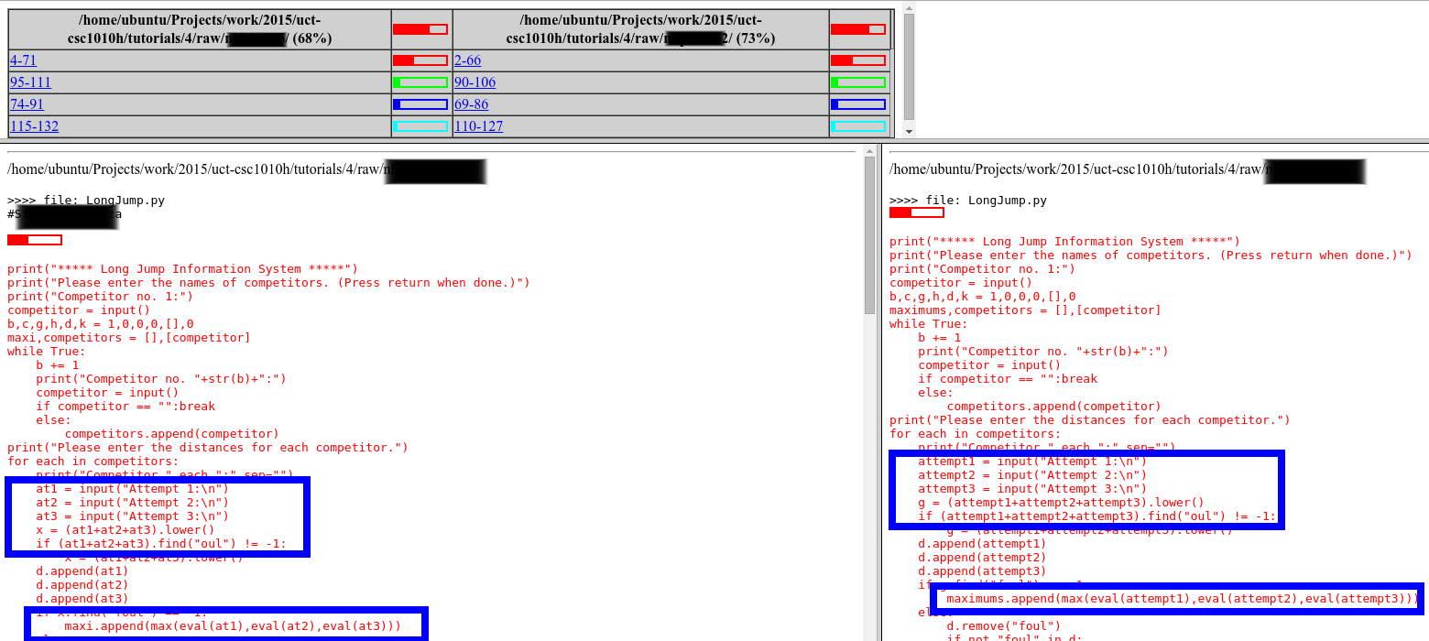
Cheating, Collusion, Plagiarism
MOSS
http://lightonphiri.org/wp-content/uploads/2015/09/moss_sample-initial_result-masked-021.png

Slide 44
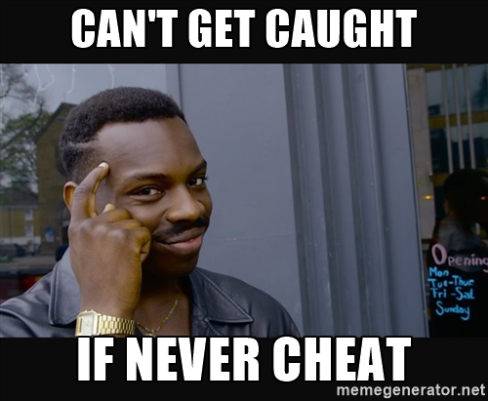

Slide 45
FIT1045: Programming Competition
Contest Format
Individual contest requiring you to write program to solve algorithmic problems
Three rounds. Tentative schedule:
Round 1: Week 4
Round 2: Week 7
Round 3: Week 11
3-6 problems in each round; each round will accept submissions for 1-2 weeks
Solutions will be automatically marked by an online judging system
Your score is the number of problems you solve
Contestants will be ranked according to their scores, and ties will be broken based on penalty (explained below)
Each incorrect submission carries a penalty. But the penalty is only applied if you finally solve the problem (e.g., say you solve problem #1 in 3 attempts and you have 3 failed attempts for problem #2 which you were unable to solve. Your score will be 1 and penalty will be 2 failed attempts on problem #1.)
Registration: to be open soon (keep an eye on Moodle)
Prizes: Trophy for the champion + Certificates for top-5 contestants
Practice: www.codeforces.com, https://uva.onlinejudge.org/

Slide 46
Recommended Reading
Levitin, A., (2012) Introduction to the Design and Analysis of Algorithms (3rd Edition) Pearson
Perkovic, L. (2012) Introduction to Computing using Python: An Application Development Focus. John Wiley & Sons, Inc.

Slide 47
Where am i?
What are algorithms
Running lectures
Unit structure
Assessment
Getting help

Slide 48
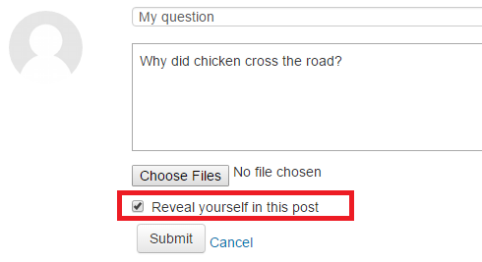
Anonymous Moodle Forum
The identity of a user is not visible to other users (including lectures)
Note: In case of appropriate usage, lecturers can still identify users by looking at logs
Rules (in addition to the rules for traditional non-anonymous forum)
Do not post hints/solutions to the assignments and workshop questions until one week after the due date
You can reveal your identity if you like

Slide 49
Help is Available
We want to help you succeed!
Lecturer
Tutors
Help Room Consultations
PASS
Moodle
Coordinators
Administration Officers

Slide 50

PARTICIPATE & ACHIEVE BETTER RESULTS
Peer-Assisted Study Sessions (pass)
Support from a successful student who has already achieved a great mark in the unit
Help with key content and concepts
Study skills for academic success at uni
A network of friends who all want to do well
The PASS Equation
1 hour of PASS = 3 hours struggling on your own

Slide 51
PARTICIPATE & ACHIEVE BETTER RESULTS
PASS GETS RESULTS
Weekly study sessions
Guaranteed study time each week to help you achieve a better mark
Students who regularly attend PASS
are less likely to fail the unit
are more likely to score a D or HD
The comparative PASS results for FIT1045 last year

Slide 52
PARTICIPATE & ACHIEVE BETTER RESULTS
SIGN UP TO PASS
Sign up for PASS via Allocate+ in Week 2
Select a FIT1045 PASS session that fits your schedule
No spots left in the session you can attend? Click on the Waiting List hyperlink on the PASS website (www.monash.edu/pass-program) and complete the form
PASS study sessions begin in Week 3. See you there!

Slide 53
Seek assistance as a preventative measure
Take the following relevant preventative measures as soon as possible, if you are falling behind in your studies:
Study difficulties: Discuss any difficulties you are experiencing with your course leader, unit coordinator, lecturer or tutor.
These staff members can assist you in identifying your problem areas and explore the options available to you in your course.
Language and learning online can help you with study methods, language skills and work presentation http://www.monash.edu.au/lls/llonline/
Student life and support services can be found at:
http://monash.edu/students/support/
and include: Health services, support and services, clubs and sports etc

Slide 54
Disability Support Services
Do you have a disability, medical or mental health condition that may impact on your study?
Disability Support Services provides a range of services for registered students including:
Note takers and Auslan interpreters
Readings in alternative formats
Adaptive equipment and software
Alternative arrangements for exam and class tests
Disability Support Services also support students who are carers of a person with a disability, medical or mental health condition, or who is aged and frail.
For further information and details about how to register:
T: 03 9905 5704
E: disabilitysupportservices@monash.edu
monash.edu/disability

Slide 55
Before Next Lecture
Log onto the FIT1045 Moodle site
Read the glossary of graph terminology.
Set up MARS.
Make a friend -> ?form a study group?
Attempt the following problem …

Slide 56
Age of the Kids
Two men meet on the street
A: All three of my sons celebrate their birthday today. Can you tell me how old each one is?
B: Yes, but you have to tell me something about them…
A: The product of their ages is 36.
B: I need more info…
A: The sum of their ages is equal to the number of windows in the building next to us…
B: I need more info…
A: My oldest son has blue eyes.
B: That is sufficient!
Notes:
56

